Slide 1
The Future of the
Takoma Park/Silver Spring Campus
June 6, 2017
Community Conversation
Notes:
Thank you!
I appreciate the opportunity to participate in these community conversations.
As the community’s college, the very foundation of our work is rooted in serving the needs of the community.
Let me say this clearly, again—I want to be a good a neighbor!
And, I need your help to be a good neighbor while delivering on the promise of the College’s mission—to this community.

Slide 2
Shared Values
Sustainability
Historic character
Residential needs
Urgent need to provide students with up-to-date labs, classrooms, and study spaces
Quick completion of construction
Fiscal discipline

Slide 3
W1/Burlington Site: The College's Conclusions
W1 is not the right site for the math and science building
W1 does not maximize interdisciplinary teaching and learning for student success
W1 would be cost prohibitive due to premium for extra materials
W1 does not meet student and Cultural Arts Center patrons’ parking needs because of lost parking. Adding parking would be cost-prohibitive
The W-1 site would be best used for future affordable expansion
Using the W-1 site does not address the rapidly deteriorating Science North and Science South buildings

Slide 4
Facilities Master Plan Vision
Fulfill a state requirement to ensure that the College has plans and programs that meet the needs of residents for access to locally provided postsecondary education.
The TP/SS Campus is a full-service undergraduate institution tasked with delivering high-quality, low-cost, locally provided postsecondary education.
The original east campus needs to be modernized. Local access to quality facilities is key to student completion and success.
Notes:
The facilities master plan is a conceptual framework required by the State.
Ensures we have a plan to manage our enrollment and have the facilities necessary to meet our mission.
We take seriously the need to balance the needs of the students, of our neighbors, the community, and fiscal prudence.

Slide 5
Facilities Master Plan Vision
Respond to and balance the needs of the students, community, neighbors, and fiscal prudence.
FMP Vision Guidelines
Develop new and renovated facilities to support academic and student programming in the support of the College’s mission.
Preserve the existing character of the existing historic neighborhood adjacent to the east campus.
Investigate future campus growth in Silver Spring.

Slide 6
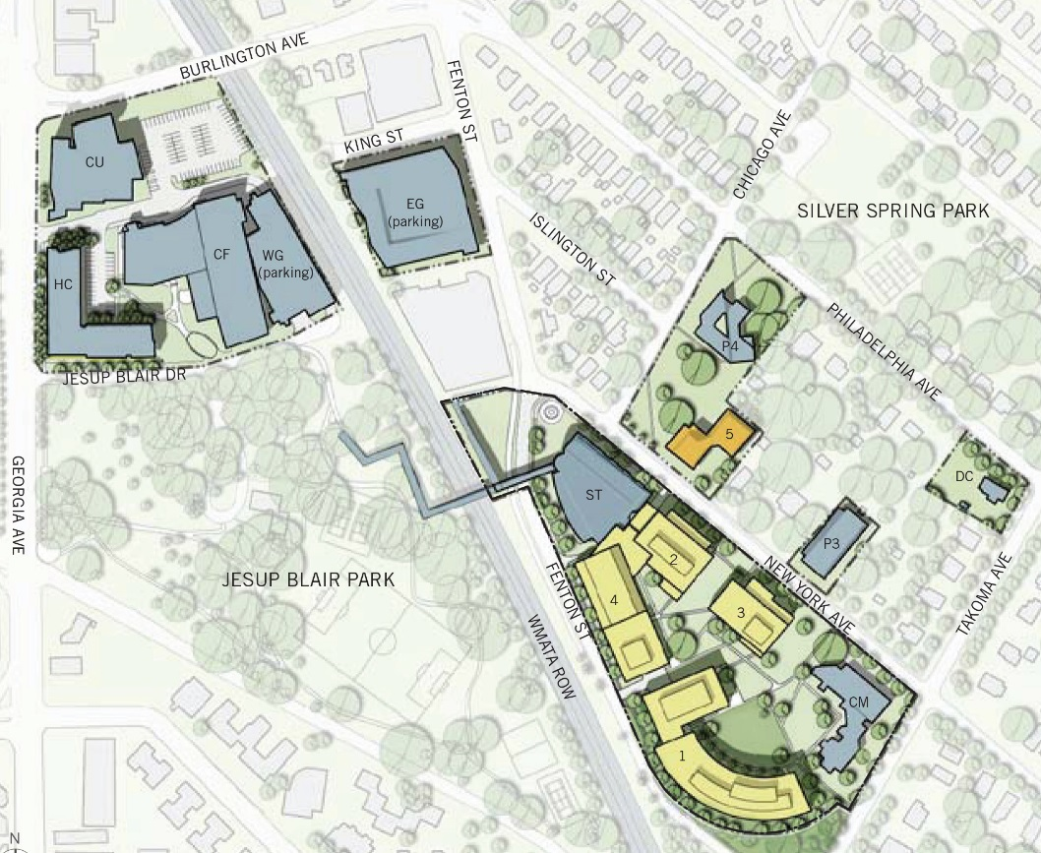
Facilities Master Plans
2006–2016
2013–2023

Slide 7
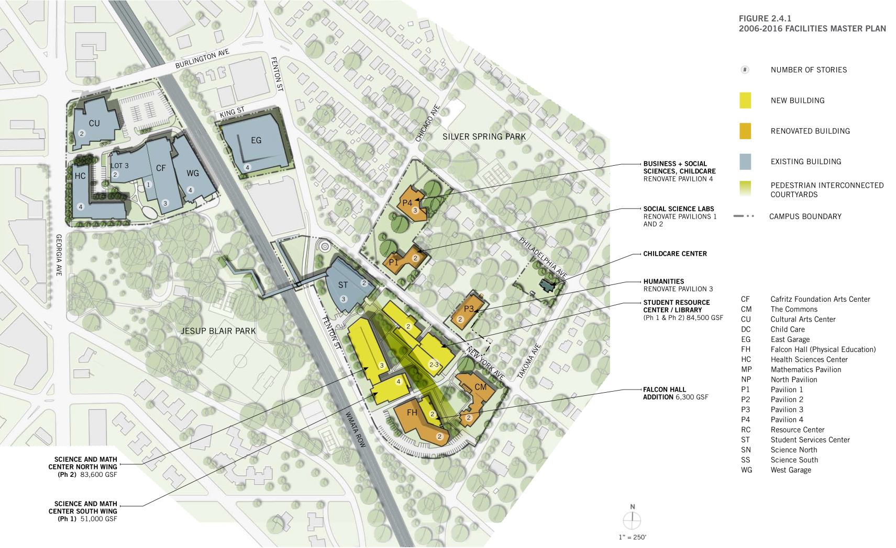
Previous Campus Plan 2006–2016
Notes:
The plan evolved in 2006 with enhanced understanding of the likely structures necessary:
Still replaces two buildings--Science South and Science North;
Likely, 4 stories plus HVAC (on the rooftop);
Still phased project—taking 8 years to complete.

Slide 8
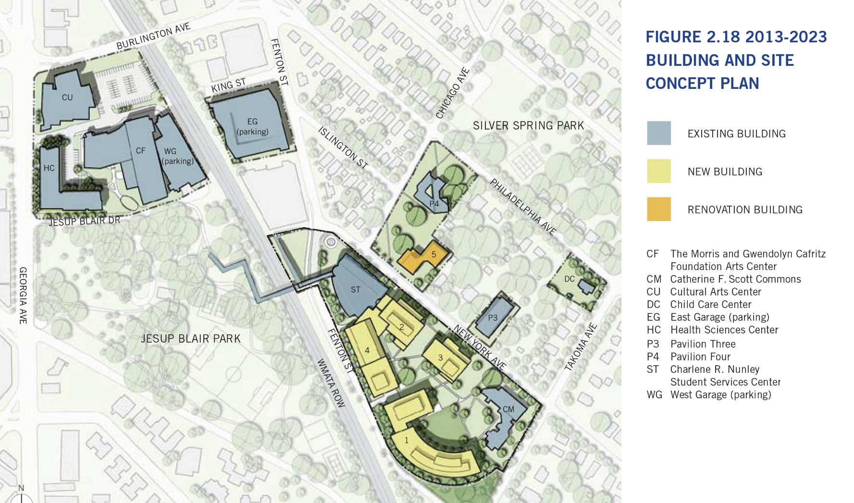
Current Campus Plan 2013–2023
Notes:
The adopted plan for 2013 acknowledged the community’s concern regarding 4 stories:
Plan envisions 1 new building;
Completed in one phase: 4 years;
Replaces Science South and Falcon Hall;
Need width to lower the height—so replaces Falcon Hall;
Plan envisions eventually replacing Falcon Hall with a Health and Fitness Center.

Slide 9
Facilities Master Plans–Major Elements
Previous Campus Plan 2006-2016
Rejuvenate the original campus (east campus)
Preserve the existing character of historic neighborhood
Foster interdisciplinary teaching and learning
Replace Science South and Science North with New Science and Math Center; 4 story; 2 phase; 8 year construction
Replace Resource Center (library) with new Student Resource Center and Library; 2 phase; 8 year
Expansion restricted to only Silver Spring
Current Campus Plan 2013-2023
Rejuvenate the original campus (east campus)
Preserve the existing character of historic neighborhood
Foster interdisciplinary teaching and learning
Replace Science South and Falcon Hall with new Math and Science Building; 1 phase; 4 years
New Library Learning Commons
Replace Resource Center
Replace Science North with new Health and Fitness Center
Shorter construction time, better continuity of instruction
Opens up campus with more green space between buildings
Expansion restricted to only Silver Spring

Slide 10
Math and Science Building
Previous Replacement Plan
4 stories
Rooftop air handling units
Gross square feet–134,000
Total project cost–$87,928,000
Dual phase
Demo Science South– Build Phase 1
Demo Science North– Build Phase 2
Project timeline–8 Years
Design
Phase 1–2 years
Phase 2 –2 years
Build
Phase 1–2 years
Phase 2 –2 years
No flexibility in design height
Current Replacement Plan
3 stories
Rooftop air handling units
Gross square feet–134,000
Total project cost–$85,628,000
Single phase
Demo Science South and Falcon Hall
Build the Entire Building
Project timeline–4 years
Design–2 years
Build–2 years
Delivers interdisciplinary building 4 years earlier
Need width to lower the height— replaces Falcon Hall
Flexibility in design height
Notes:
(Read slide)

Slide 11
Design Guidelines as a result of Community Conversations
Create a design that integrates the building with the existing campus and neighborhood.
Coordinate building size with the overall character and scale of the other buildings on campus and the immediate neighborhood.
Maintain the existing set-back of Falcon Hall in accordance with state, county, and municipal regulations.
Maintain the existing trees and green space to the extent practicable. Add intermediary landscaped elements between buildings and walkways to enhance the green space.

Slide 12
Construction Mitigation as a result of Community Conversations
Coordinate construction to minimize disruption to classes and events on campus/in community.
Meet or exceed noise control regulations of Takoma Park Municipal Code Chapter 14.12 Noise Control.
Provide additional off-site parking for students, faculty, and staff.
Provide “cell phone lot” for student pick up.
Mandate off-site parking for construction crews.
Mandate off-site parking for construction delivery trucks.

Slide 13
Supporting Documents
www.montgomerycollege.edu/conversations

Slide 14
Questions and Comments
community@montgomerycollege.edu

